Slide 1
SQL Part 2
Ch 8 Exercises 20-27 in the Textbook

Slide 2


Slide 3
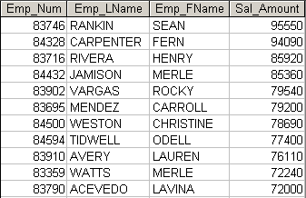
Write a query to display the current salary for each employee in department 300. Assume that only current employees are kept in the system, and therefore the most current salary for each employee is the entry in the salary history with a NULL end date. Sort the output in descending order by salary amount. (Figure P8.20)
Figure P8.20 Current salary for employees in department 300

Slide 5
Write a query to display the current salary for each employee in department 300. Assume that only current employees are kept in the system, and therefore the most current salary for each employee is the entry in the salary history with a NULL end date. Sort the output in descending order by salary amount. (Figure P8.20)
Figure P8.20 Current salary for employees in department 300
SELECT e.emp_num, emp_lname, emp_fname, sal_amount
FROM lgemployee e JOIN lgsalary_history s ON e.emp_num = s.emp_num
WHERE sal_end IS NULL
AND dept_num = 300
ORDER BY sal_amount DESC;

Slide 6
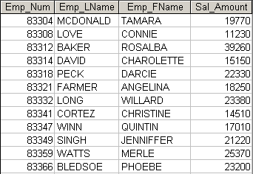
Write a query to display the starting salary for each employee. The starting salary would be the entry in the salary history with the oldest salary start date for each employee. Sort the output by employee number. (Figure P8.21)
Figure P8.21 Starting salary for each employee

Slide 8
Write a query to display the starting salary for each employee. The starting salary would be the entry in the salary history with the oldest salary start date for each employee. Sort the output by employee number. (Figure P8.21)
Figure P8.21 Starting salary for each employee
SELECT e.emp_num, emp_lname, emp_fname, sal_amount
FROM lgemployee e join lgsalary_history s ON e.emp_num = s.emp_num
WHERE sal_from = (SELECT Min(sal_from)
FROM lgsalary_history s2 WHERE e.emp_num = s2.emp_num)
ORDER BY e.emp_num;

Slide 9
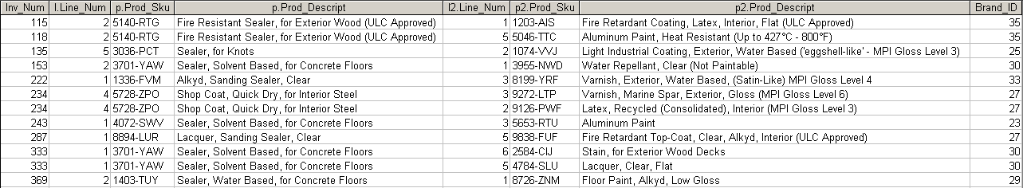
Write a query to display the invoice number, line numbers, product SKUs, product descriptions, and brand ID for sales of sealer and top coat products of the same brand on the same invoice. (Figure P8.22)
Figure P8.22 Invoices for sealer and top coat of the same brand

Slide 11
Write a query to display the invoice number, line numbers, product SKUs, product descriptions, and brand ID for sales of sealer and top coat products of the same brand on the same invoice. (Figure P8.22)
Figure P8.22 Invoices for sealer and top coat of the same brand
SELECT l.inv_num, l.line_num, p.prod_sku, p.prod_descript, l2.line_num, p2.prod_sku, p2.prod_descript, p.brand_id
FROM (lgline l join lgproduct p ON l.prod_sku = p.prod_sku) join
(lgline l2 join lgproduct p2 ON l2.prod_sku = p2.prod_sku)
ON l.inv_num = l2.inv_num
WHERE p.brand_id = p2.brand_id
AND p.prod_category = 'Sealer'
AND p2.prod_category = 'Top Coat'
ORDER BY l.inv_num, l.line_num;

Slide 12

The Binder Prime Company wants to recognize the employee who sold the most of their products during a specified period. Write a query to display the employee number, employee first name, employee last name, e-mail address, and total units sold for the employee who sold the most Binder Prime brand products between November 1, 2015, and December 5, 2015. If there is a tie for most units sold, sort the output by employee last name. (Figure P8.23)
Figure P8.23 Employees with most Binder Prime units sold

Slide 14
The Binder Prime Company wants to recognize the employee who sold the most of their products during a specified period. Write a query to display the employee number, employee first name, employee last name, e-mail address, and total units sold for the employee who sold the most Binder Prime brand products between November 1, 2015, and December 5, 2015. If there is a tie for most units sold, sort the output by employee last name. (Figure P8.23)
Figure P8.23 Employees with most Binder Prime units sold
SELECT emp.emp_num, emp_fname, emp_lname, emp_email, total
FROM lgemployee emp JOIN
(SELECT employee_id, Sum(line_qty) AS total
FROM lginvoice i join lgline l ON i.inv_num = l.inv_num
JOIN lgproduct p ON l.prod_sku = p.prod_sku
JOIN lgbrand b ON b.brand_id = p.brand_id
WHERE brand_name = 'BINDER PRIME'
AND INV_DATE BETWEEN '01-NOV-15' AND '06-DEC-15'
GROUP BY employee_id) sub
ON emp.emp_num = sub.employee_id
WHERE total = (SELECT Max(total)
FROM (SELECT employee_id, Sum(line_qty) AS total
FROM lginvoice i JOIN lgline l ON i.inv_num = l.inv_num
JOIN lgproduct p ON l.prod_sku = p.prod_sku
JOIN lgbrand b ON b.brand_id = p.brand_id
WHERE brand_name = 'BINDER PRIME'
AND INV_DATE BETWEEN '01-NOV-15' AND '06-DEC-15'
GROUP BY employee_id));

Slide 15
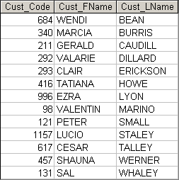
Write a query to display the customer code, first name, and last name of all customers who have had at least one invoice completed by employee 83649 and at least one invoice completed by employee 83677. Sort the output by customer last name and then first name. (Figure P8.24)
Figure P8.24 Customers with invoices filled by employees 83649 and 83677

Slide 17
Write a query to display the customer code, first name, and last name of all customers who have had at least one invoice completed by employee 83649 and at least one invoice completed by employee 83677. Sort the output by customer last name and then first name. (Figure P8.24)
Figure P8.24 Customers with invoices filled by employees 83649 and 83677
SELECT c.cust_code, cust_fname, cust_lname
FROM lgcustomer c JOIN lginvoice i ON c.cust_code = i.cust_code
WHERE employee_id = 83649
INTERSECT
SELECT c.cust_code, cust_fname, cust_lname
FROM lgcustomer c JOIN lginvoice i ON c.cust_code = i.cust_code
WHERE employee_id = 83677
ORDER BY cust_lname, cust_fname;

Slide 18
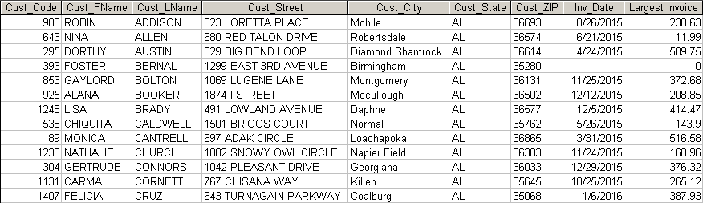
LargeCo is planning a new promotion in Alabama (AL) and wants to know about the largest purchases made by customers in that state. Write a query to display the customer code, customer first name, last name, full address, invoice date, and invoice total of the largest purchase made by each customer in Alabama. Be certain to include any customers in Alabama who have never made a purchase (their invoice dates should be NULL and the invoice totals should display as 0). (Figure P8.25)
Figure P8.25 Largest purchases of customers in Alabama

Slide 20
LargeCo is planning a new promotion in Alabama (AL) and wants to know about the largest purchases made by customers in that state. Write a query to display the customer code, customer first name, last name, full address, invoice date, and invoice total of the largest purchase made by each customer in Alabama. Be certain to include any customers in Alabama who have never made a purchase (their invoice dates should be NULL and the invoice totals should display as 0). (Figure P8.25)
Figure P8.25 Largest purchases of customers in Alabama
SELECT c.cust_code, cust_fname, cust_lname, cust_street, cust_city, cust_state, cust_zip,
inv_date, inv_total AS "Largest Invoice"
FROM lgcustomer c JOIN lginvoice i ON c.cust_code = i.cust_code
WHERE cust_state = 'AL'
AND inv_total = (SELECT Max(inv_total)
FROM lginvoice i2
WHERE i2.cust_code = c.cust_code)
UNION
SELECT cust_code, cust_fname, cust_lname, cust_street, cust_city, cust_state, cust_zip, NULL, 0
FROM lgcustomer
WHERE cust_state = 'AL'
AND cust_code NOT IN (SELECT cust_code FROM lginvoice)
ORDER BY cust_lname, cust_fname;

Slide 21
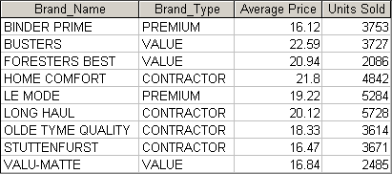
One of the purchasing managers is interested in the impact of product prices on the sale of products of each brand. Write a query to display the brand name, brand type, average price of products of each brand, and total units sold of products of each brand. Even if a product has been sold more than once, its price should only be included once in the calculation of the average price. However, you must be careful because multiple products of the same brand can have the same price, and each of those products must be included in the calculation of the brand’s average price. (Figure P8.26)
Figure P8.26 Average price and total units sold of products by brand

Slide 23
One of the purchasing managers is interested in the impact of product prices on the sale of products of each brand. Write a query to display the brand name, brand type, average price of products of each brand, and total units sold of products of each brand. Even if a product has been sold more than once, its price should only be included once in the calculation of the average price. However, you must be careful because multiple products of the same brand can have the same price, and each of those products must be included in the calculation of the brand’s average price. (Figure P8.26)
Figure P8.26 Average price and total units sold of products by brand
SELECT brand_name, brand_type, Round(avgprice,2) AS "Average Price", "Units Sold"
FROM lgbrand b JOIN (SELECT brand_id, Avg(prod_price) AS avgprice
FROM lgproduct
GROUP BY brand_id) sub1
ON b.brand_id = sub1.brand_id
JOIN (SELECT brand_id, Sum(line_qty) AS "Units Sold"
FROM lgproduct p JOIN lgline l ON p.prod_sku = l.prod_sku
GROUP BY brand_id) sub2
ON b.brand_id = sub2.brand_id
ORDER BY brand_name;

Slide 24
The purchasing manager is still concerned about the impact of price on sales. Write a query to display the brand name, brand type, product SKU, product description, and price of any products that are not a premium brand, but that cost more than the most expensive premium brand products. (Figure P8.27)
Figure P8.27 Nonpremium products that are more expensive than premium products

Slide 25
The purchasing manager is still concerned about the impact of price on sales. Write a query to display the brand name, brand type, product SKU, product description, and price of any products that are not a premium brand, but that cost more than the most expensive premium brand products. (Figure P8.27)
Figure P8.27 Nonpremium products that are more expensive than premium products
SELECT brand_name, brand_type, prod_sku, prod_descript, prod_price
FROM lgproduct p JOIN lgbrand b ON p.brand_id = b.brand_id
WHERE brand_type <> 'PREMIUM'
AND prod_price > (SELECT Max(prod_price)
FROM lgproduct p JOIN lgbrand b ON p.brand_id = b.brand_id
WHERE brand_type = 'PREMIUM');

Slide 26
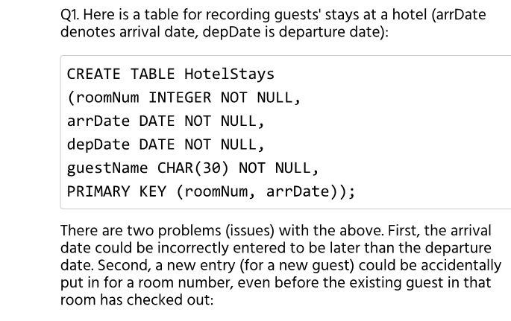
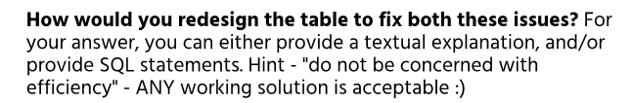

Slide 27
RoomNumber Date GuestName
-----------------
CREATE TABLE HotelStays
(roomNum INTEGER NOT NULL,
date DATE NOT NULL,
guestName CHAR(30) NOT NULL,
PRIMARY KEY (roomNum, date));
In other words, create a distinct row for each day a guest stays in a room! That will avoid duplicates (overlaps), and get rid of the problem of end<start.

Slide 28
CREATE OR REPLACE FUNCTION date_validator() RETURNS TRIGGER AS $exe$
BEGIN
IF NEW.arrDate > NEW.depDate Then
delete from HotelStays where (roomNum = NEW.roomNum AND arrDate = NEW.arrDate);
ELSEIF EXISTS(select arrDate, depDate from HotelStays where ((NEW.arrDate >arrDate AND NEW.arrDate<depDate)OR (NEW.depDate >arrDate AND NEW.depDate<depDate)OR (NEW.depDate >depDate AND NEW.arrDate<arrDate))) Then
delete from HotelStays where (roomNum = NEW.roomNum AND arrDate = NEW.arrDate);
END IF;
RETURN NEW;
END;
$exe$
Language plpgsql;
create trigger date_valid
AFTER INSERT ON HotelStays
FOR EACH ROW EXECUTE PROCEDURE date_validator();
INSERT INTO HotelStays VALUES (123, to_date('20160202', 'YYYYMMDD'), to_date('20160206','YYYYMMDD'), 'A');
INSERT INTO HotelStays VALUES (123, to_date('20160204', 'YYYYMMDD'), to_date('20160208','YYYYMMDD'), 'B');
INSERT INTO HotelStays VALUES (201, to_date('20160210', 'YYYYMMDD'), to_date('20160206','YYYYMMDD'), 'C');

